Slide 1
Smart City Management System
By
Rayyan ahmed (21k-3079)
Abdul Rafay (21k-3051)

Slide 2
About the System
The Smart City management system is a computer system that helps students and employees
For students, they will be provided with all the available scholarship to them according to their GPA and all their data will be stored in a CSV file.
For Employees, they will be provided with all the available job opportunities according to their years of experience and also their data will be stored in a CSV file.

Slide 3
GUI Used
GUI used in this system is “Swing”
About Swing:
Swing is a set of program component s for Java programmers that provide the ability to create graphical user interface ( GUI ) components, such as buttons and scroll bars, that are independent of the windowing system for specific operating system .

Slide 4
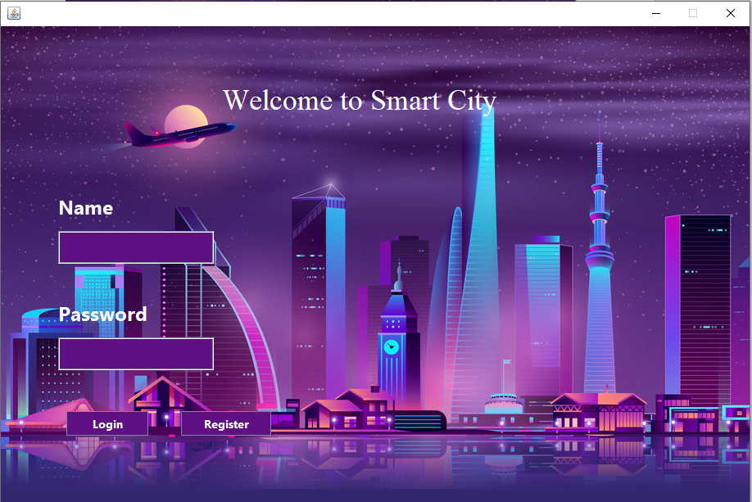
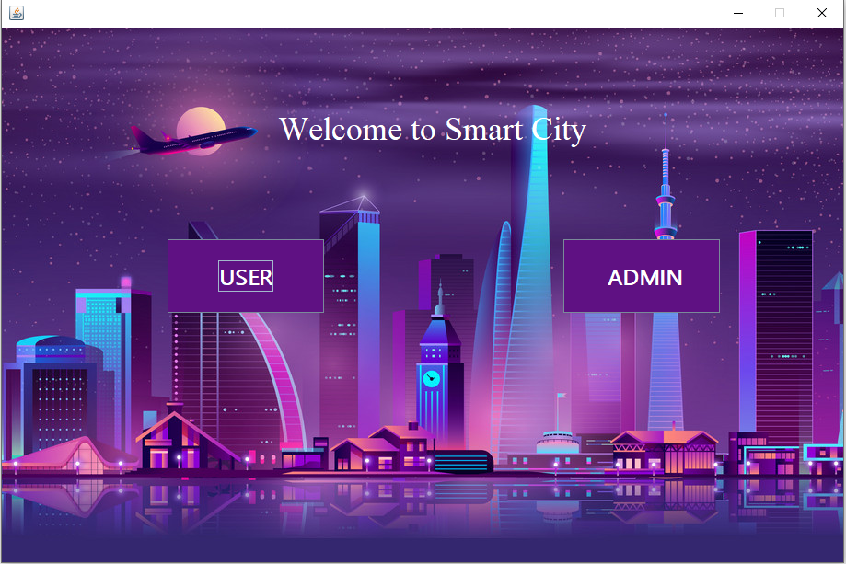
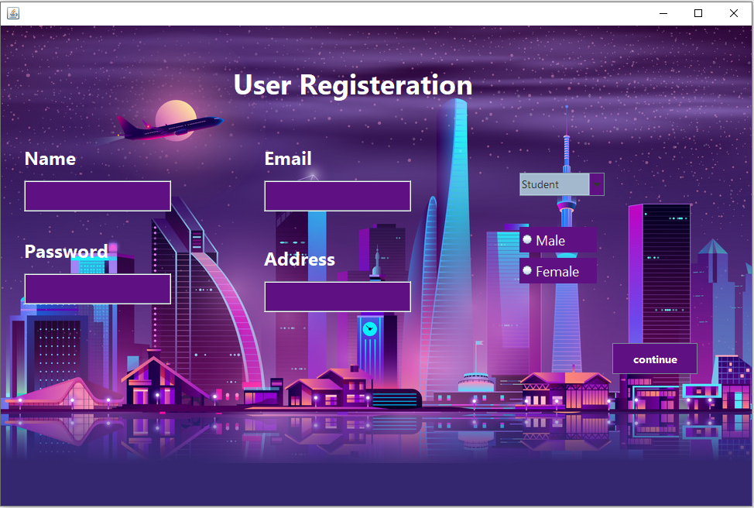

Slide 5
NOW TOWARDS LIVE DEMONSTRATION ☺

